Slide 1
Comparative Analysis of Food Production Index, Total Reserves and Arms Imports of Spain and European Countries
Neha Kumari
Data Science & Business Analytics
Saint Peter’s University, Jersey City, NJ

Slide 2
Objective
Compare the following indicators of Spain with Germany, Italy and Morocco.
Food Production Index
Total Reserves
Arms Imports

Slide 3
Food Production Index
Food production index covers food crops that are considered edible and that contain nutrients.
Coffee and tea are excluded because, although edible, they have no nutritive value.
FPI varies from region to region as it depends upon the climate, soil and water availability.

Slide 4
Total Reserves
Total Reserves comprise holdings of monetary gold, reserves of IMF members and holdings of foreign exchange.
The gold component of these reserves is valued at year end (Dec 31) London prices.
Data are in current US dollars.

Slide 5
Arms Imports
Arms Imports cover the supply of military weapons through sales, aid, gifts and those made through manufacturing licenses.
Data cover major conventional weapons such as aircraft, armored vehicles, radar systems etc.

Slide 6
Arms Imports Contd…
Excluded are transfers of other military equipment such as small arms and light weapons, trucks, small artillery, ammunition, support equipment and other services.

Slide 7
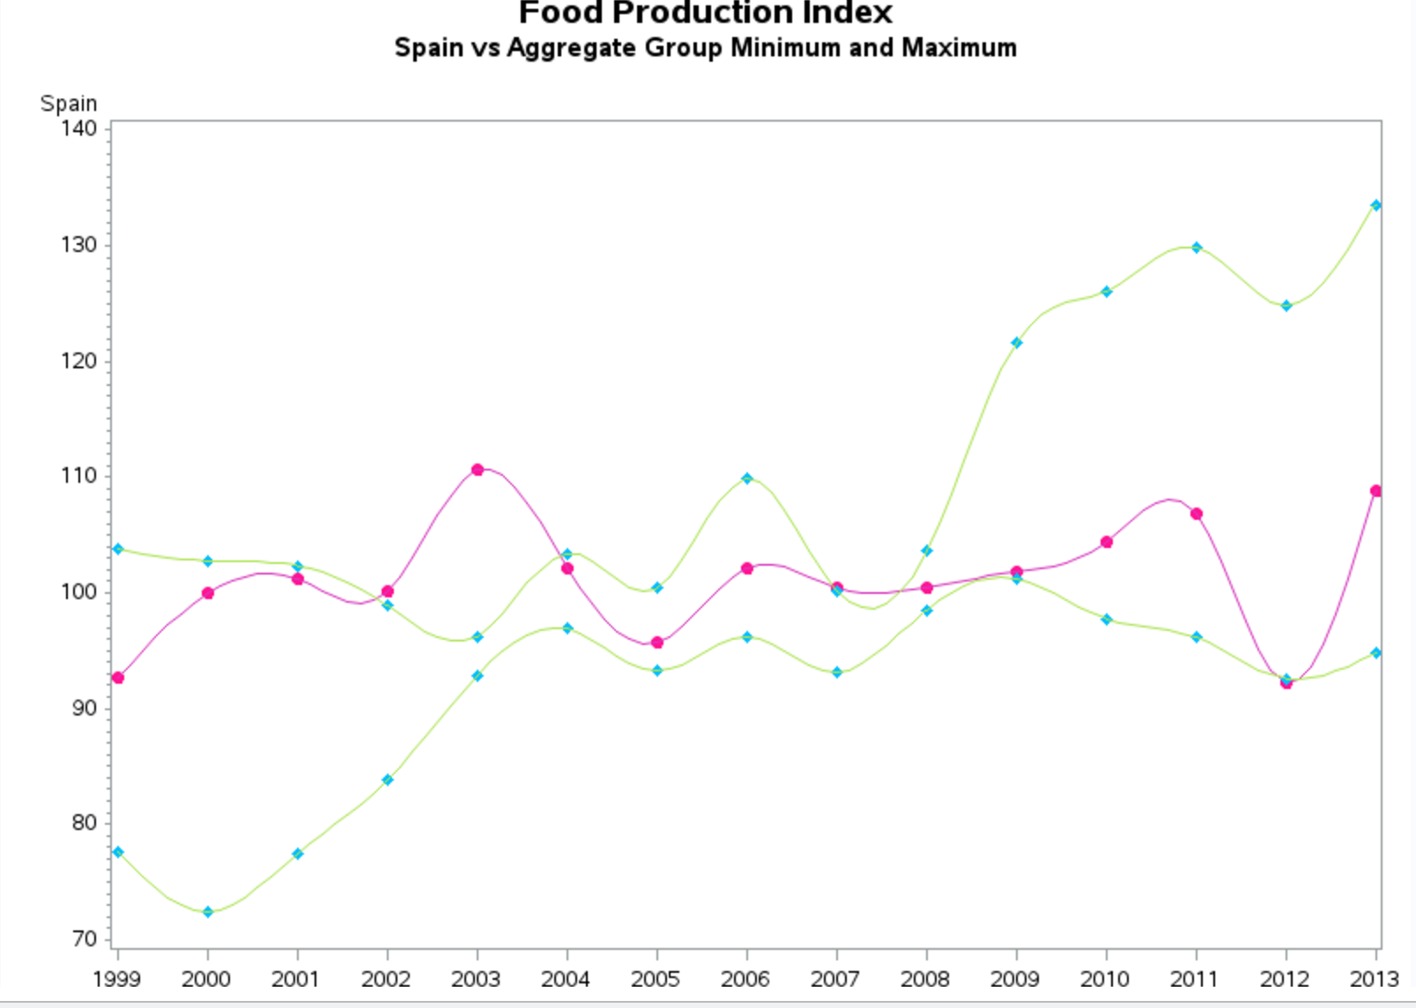

Slide 8
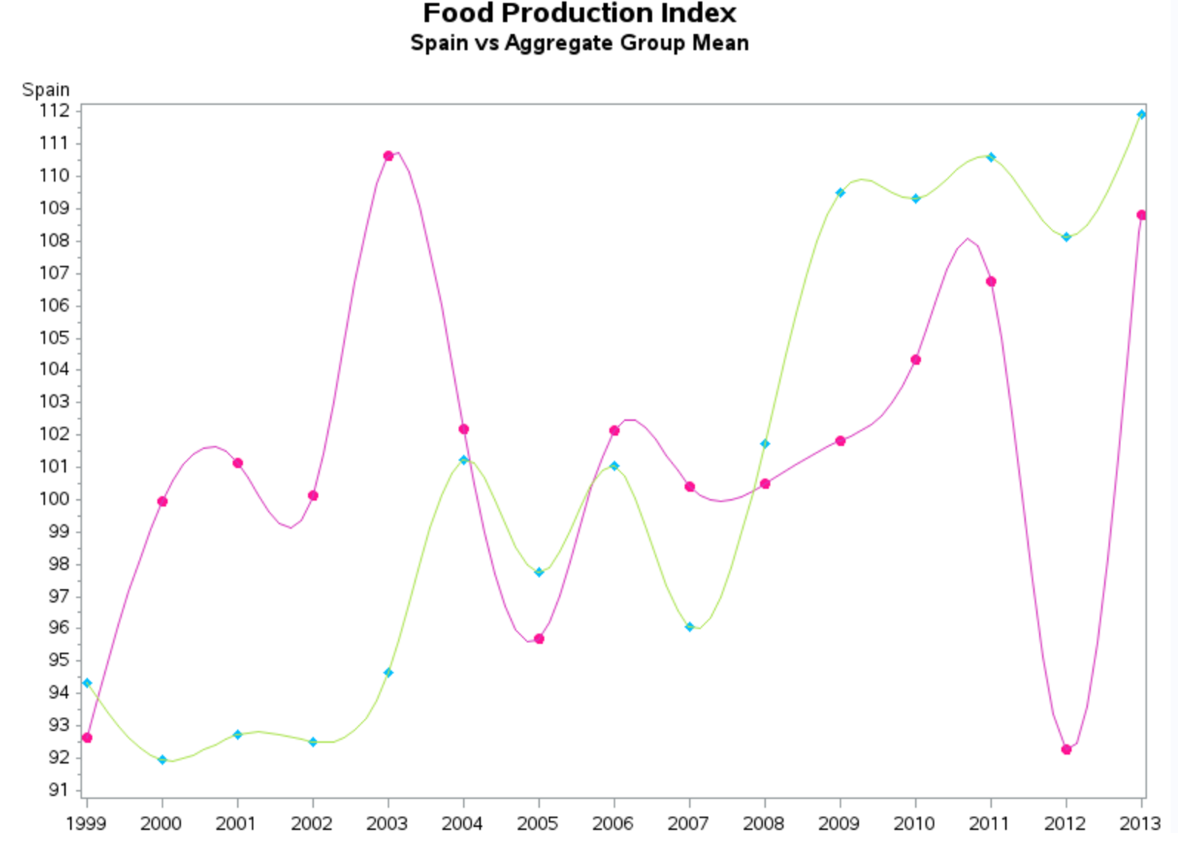

Slide 9
Observations
FPI of Spain was comparatively higher in 2003 with both the maximum and minimum of the aggregate group
There is a sharp decline in FPI of Spain during 2012 and is equal to the minimum of the aggregate group

Slide 10
Observations Contd…
There is a high variation in FPI of Spain with the aggregate mean.
The variation is less during the period of 2004-2008.

Slide 11
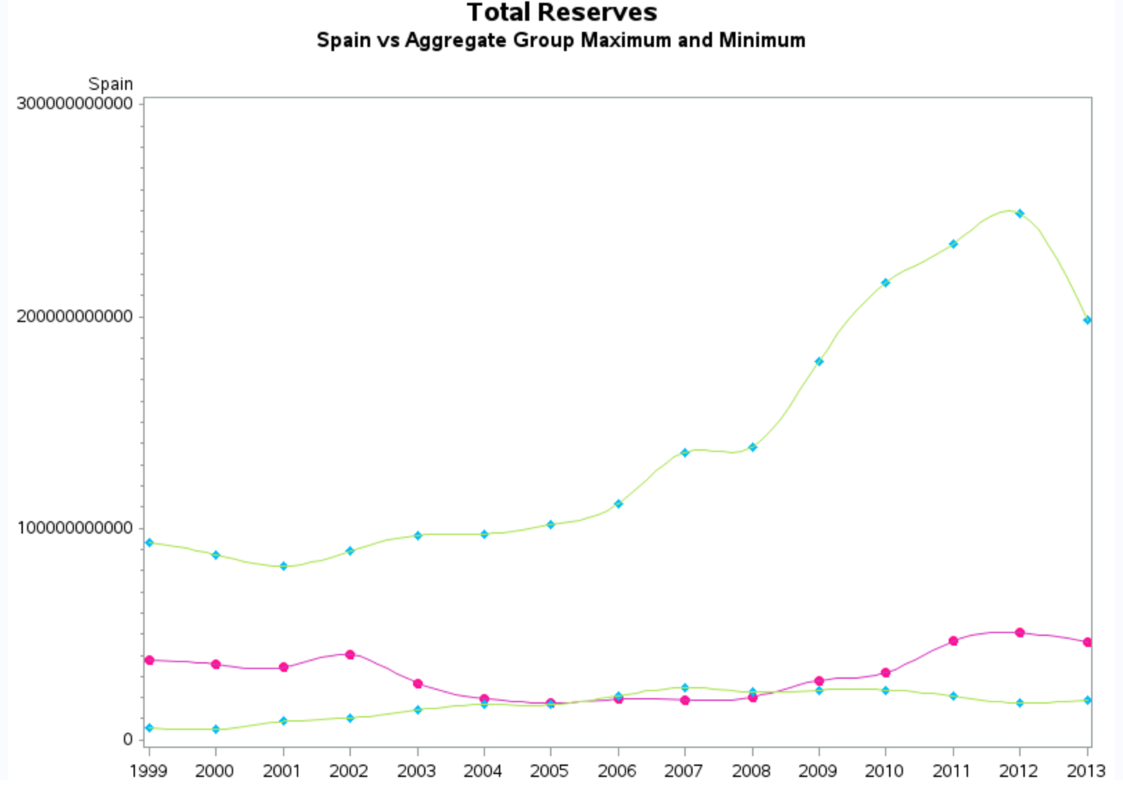

Slide 12
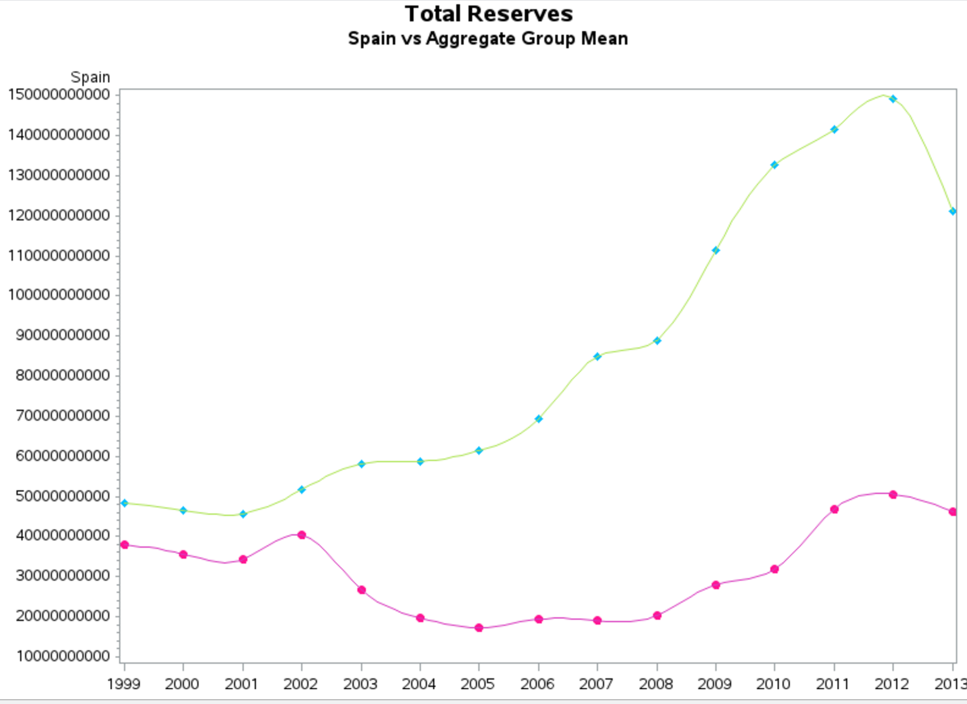

Slide 13
Observations
The total reserves of Spain is greater than the minimum and less than the maximum of the aggregate group reserves.
During the period of 2006-2008 the reserves of Spain declined and were less than the minimum of aggregate reserves

Slide 14
Observations Contd…
The mean of the reserves of aggregate group have always been higher than Spain.
The variation has increased with time as observed from the plot.

Slide 15
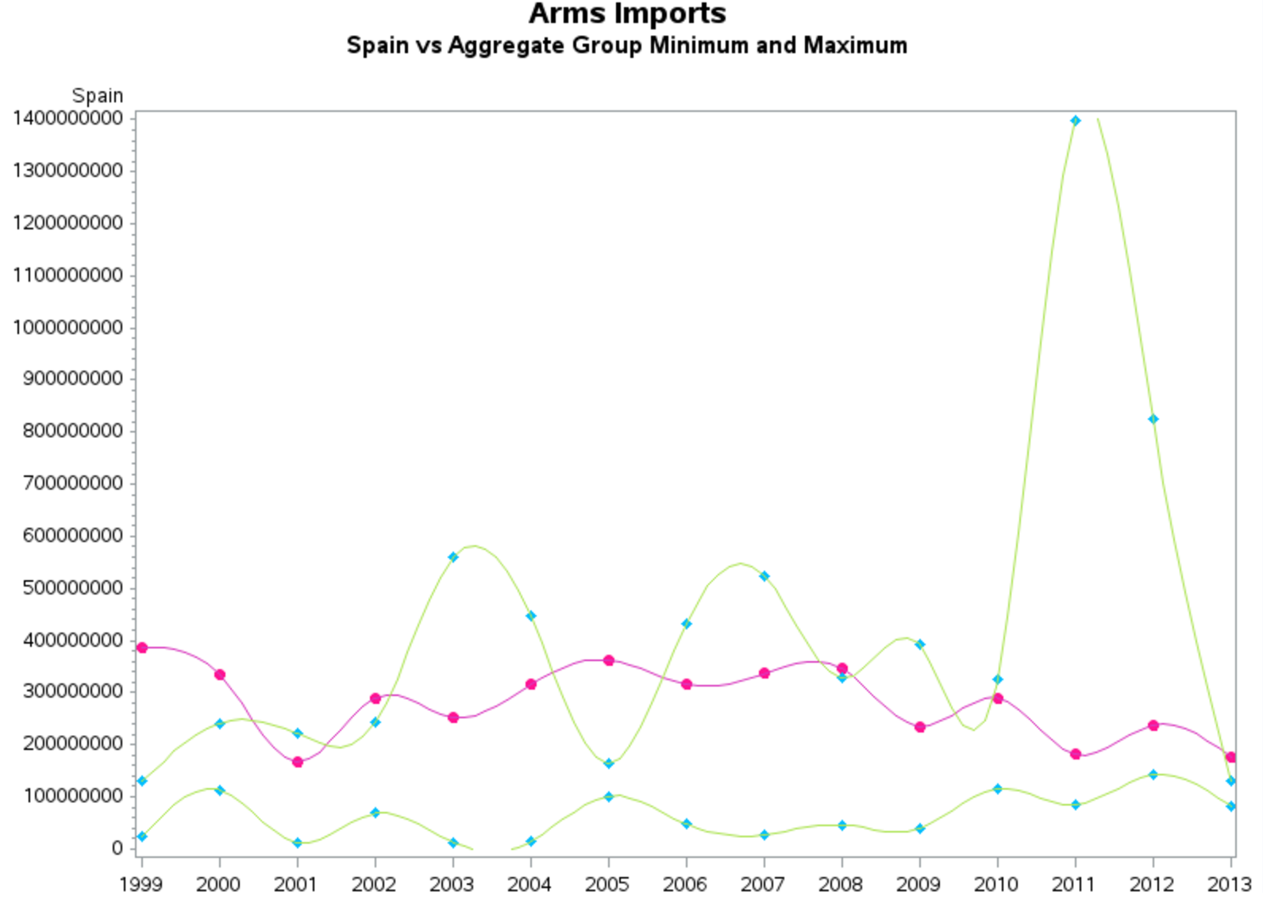

Slide 16
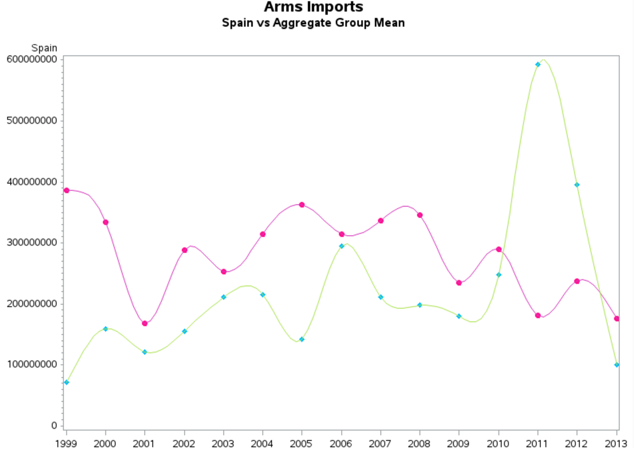

Slide 17
Observations
The Arms Imports of Spain is greater than the minimum of the aggregate group.
The Imports have not varied considerably over the period of time.
2012-2013 observes a sharp increase in the imports of the aggregate group.

Slide 18
Observations Contd…
The Imports are higher than the mean of aggregate group.

Slide 19
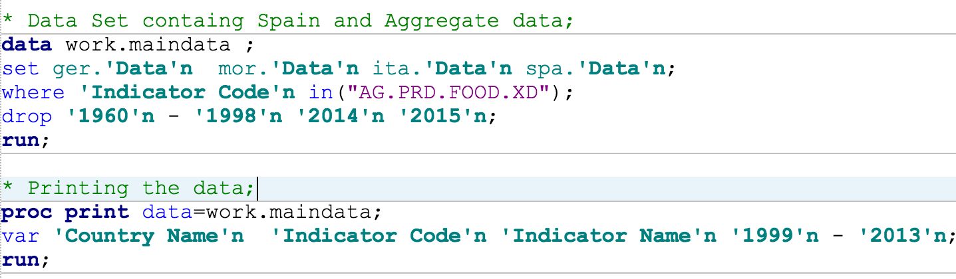
Procedure
Create a data set containing the base country data and the excel data

Slide 20
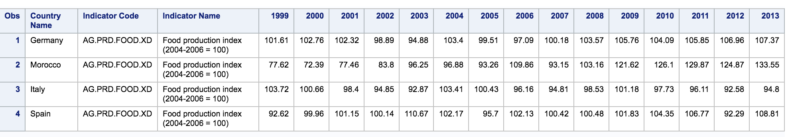
Procedure

Slide 21
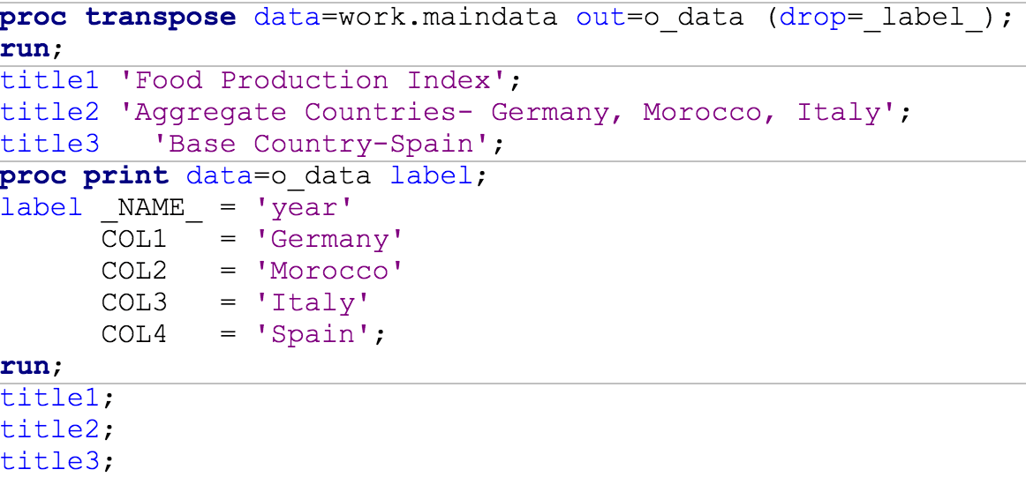
Procedure
Transpose the data set

Slide 22
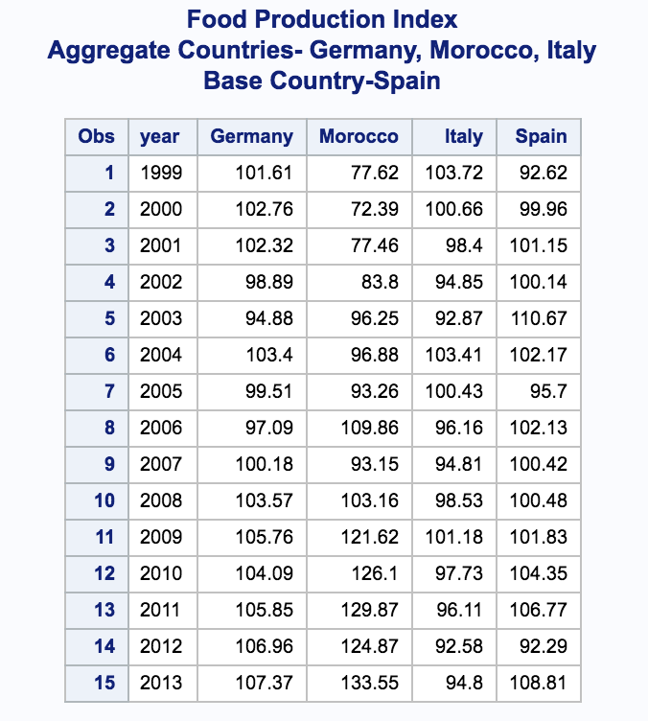
Procedure

Slide 23
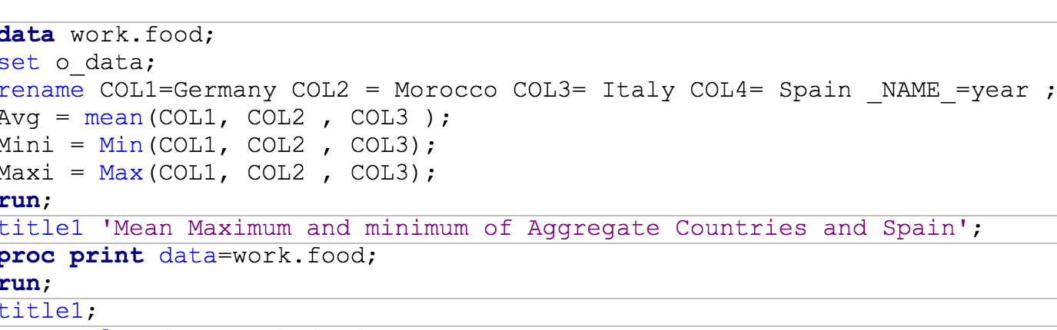
Procedure
Apply mean, max and min function on the aggregate group.

Slide 24
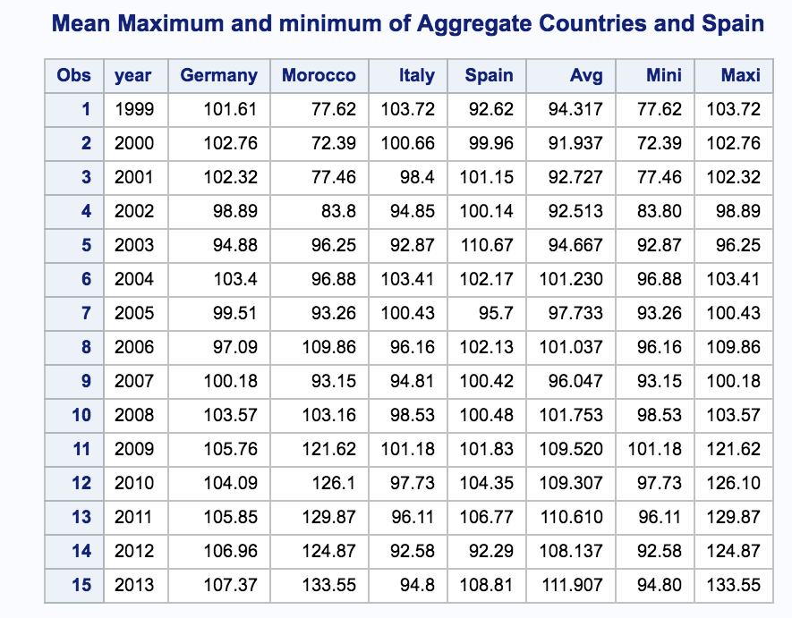
Procedure

Slide 25
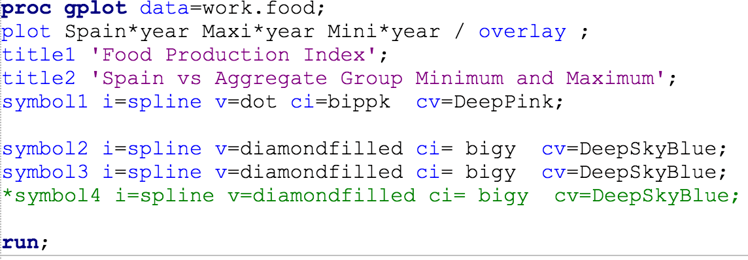
Procedure
Plots
Maximum and minimum plot of Spain Vs Aggregate countries

Slide 26
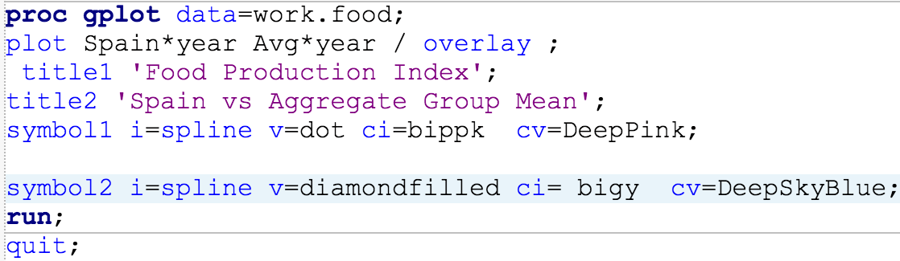
Procedure
Plots
Spain Vs Mean of Aggregate countries

Slide 27
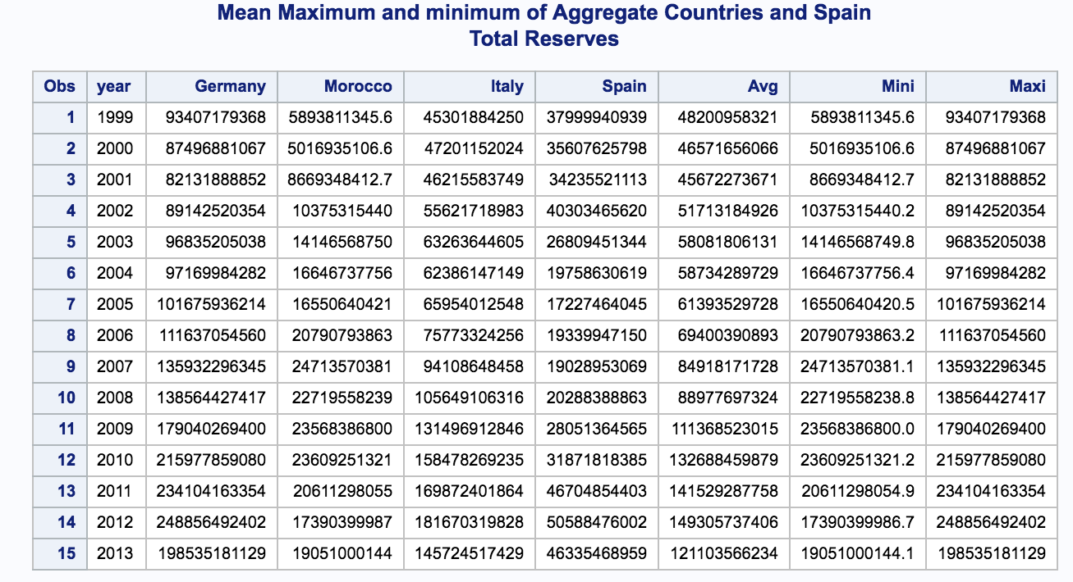
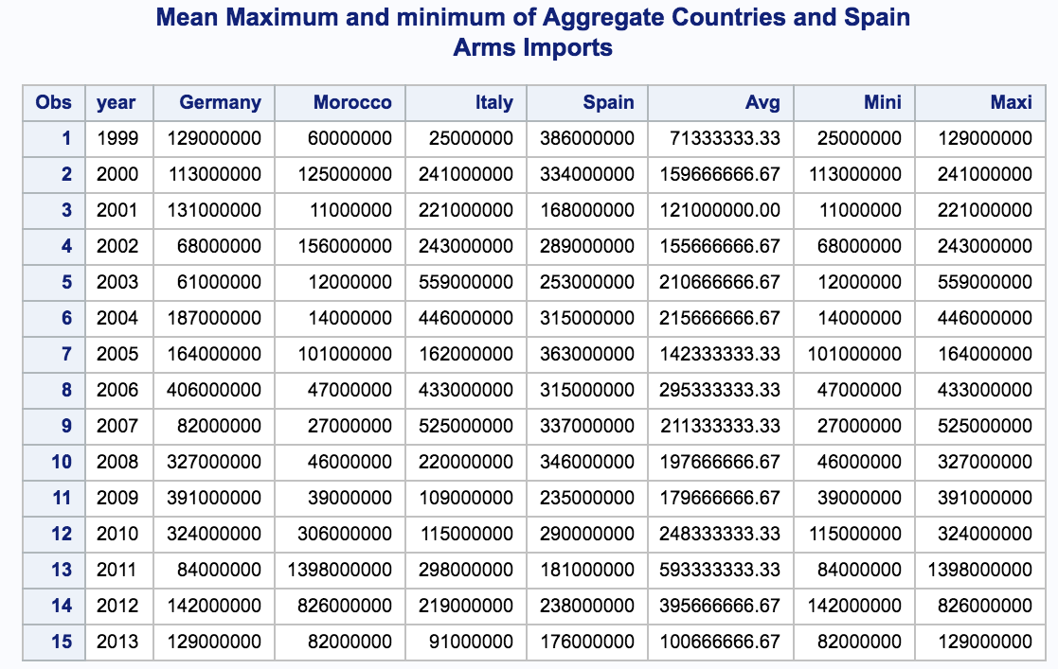
Procedure
The same procedure is applied for other 2 indicators
The output is shown below

Slide 28
Conclusions
FPI in Spain sharply declined during 2012 but regained during 2013
The total reserves of Spain have not varied much over the 15 years(1999-2013) compared to it’s other neighboring countries(Germany, Italy, Morocco).

Slide 29
Conclusions Cont…
The Arms Imports have not varied much over the last 15 years(1999-2013), while there has been a sharp increase in the imports in it’s neighboring countries, especially Germany

